Slide 1
WA National Standard Medication Chart (NSMC) Audit 2024
Train the Trainer

Slide 2
Acknowledgement of country
May I first acknowledge the Whadjuk people of the Noongar nation, the traditional custodians of this land who are resilient in their custodianship
Let us celebrate their culture today and every day, and note how privileged we are to share this country
I pay my respects to elders: past, present and emerging

Slide 3
WA National Standard Medication Chart (NSMC) Audit
In previous years, the Australian Commission for Safety and Quality in Health Care (ACSQHC) had coordinated a biennial NSMC Audit. The last NSMC Audit was conducted in October 2022.
In 2024 WA will be conducting an abridged statewide audit between Tuesday 5 November and Monday 18 November which focuses on key areas identified for improvement from the 2022 audit.
Using and auditing the NSMC are activities that can be used to demonstrate compliance with the NSQHS Standards for accreditation.
It is a policy compliance requirement for WA sites to participate in this statewide audit as per Medication Chart Policy MP0078/18.

Slide 4
WA 2024 NSMC Audit Objectives
Review areas identified as requiring improvement from the nationwide NSMC audit in 2022:
  Patient Identification
  Adverse Drug Reactions (ADR)
  Venous Thromboembolism (VTE) risk assessment

Slide 5
WA NSMC Audit
Data Collection Tools
Paper based form, available at:
http://ww2.health.wa.gov.au/Articles/U_Z/WA-Hospital-Medication-Chart
The WA NSMC 2024 audit will be coordinated via REDCap
https://datalibrary-rc.health.wa.gov.au/surveys/?s=P83PEDAJW8DTDTDE

Slide 6
Preparing for the NSMC Audit
Site Coordinators will require access to the REDCap project to be able to run reports for their site.
Register for access to REDCap
  Complete the registration form
Users will then email MTU to request access to the National Standard Medication Chart Audit 2024 REDCap® project.
Auditors can use the REDCap link provided to enter data, alternatively they can request access to the REDCap project if deemed appropriate by Site coordinators

Slide 7
Number and type of charts to audit
Suggested audit sample size:
Ideally all available active WA Hospital Medication Charts (WA HMC), adult and paediatric, should be reviewed.
It is recommended that as many medication charts are reviewed as possible to identify of errors that occur infrequently and to evaluate any significant changes to medication safety
Hospital bed numbers | Sample size
150 or more | 20% of current inpatients
30 – 149 | 30 current inpatients
Less than 30 | All current inpatients

Slide 8
Audit teams
Multidisciplinary audit teams are recommended to reflect the way in which clinicians use the WA Hospital Medication Chart (WA HMC – Adult and Paediatric)
Ideally it should be conducted by 2 people together:
  To minimise observer bias
  Should include:
    A registered nurse
    A pharmacist (or medical officer, or another nurse)
The teams should be allocated and maintained for the audit period, to ensure consistency in the data collected.
As the 2024 audit focuses on 3 key medication safety features (which may have less risk of observer bias), it may be acceptable to conduct the audit as an individual.

Slide 9
Recommendations
A paper tool (one page per patient) has been provided to assist auditors in collecting the information prior to upload into REDcap®.
Auditors involved with audit data entry will need to familiarise themselves with the REDCap® Audit tool.
It is suggested that you maintain a log of frequently occurring errors/issues that can be used as examples in your report.
  e.g. Use of patient ID labels without first prescriber handwriting patient name
  e.g. Partially complete or incomplete ADR documentation
  Can be used for education/improvement at each site
Take de-identified photos/photocopies of any major issues – to present to sites Medicines & Therapeutics Committee or Medication Safety Group
  May be a once-off event
  May be part of a pattern

Slide 10
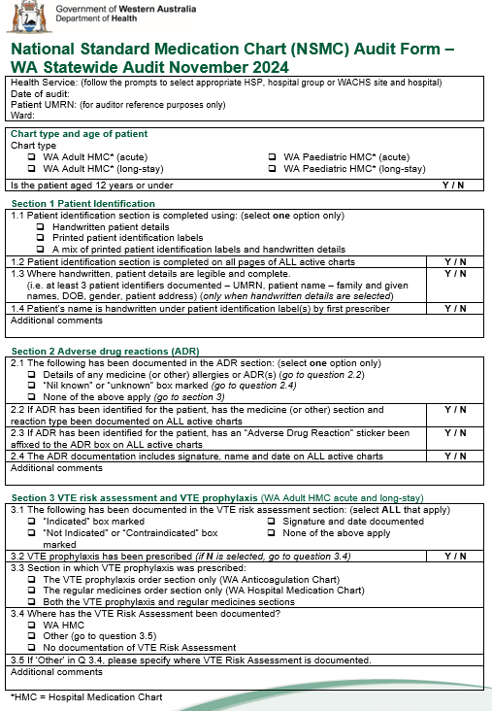
Completing the Audit

Slide 11
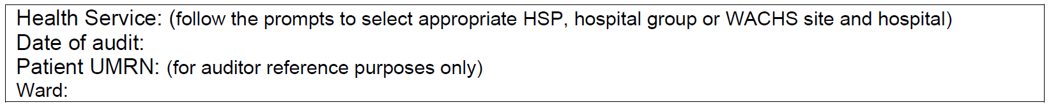
Completing the Audit Tool
Complete one paper audit tool per patient
Complete all fields on top of page:
  Health Service
  Date of audit
  Unique Medical Record Number (UMRN) and ward – this documentation is for auditor reference purpose only

Slide 12
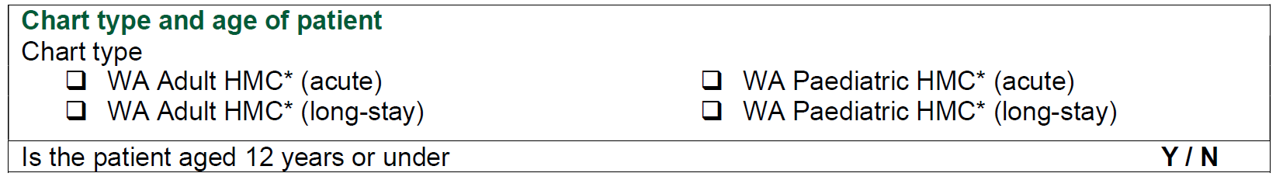
Chart type and age of patient
Record the chart type being audited for the patient
For adult charts – select either WA Adult HMC acute or long-stay version
For paediatric charts – select either WA Paediatric HMC acute or long-stay version
Only include charts that are “active” and in current use at the time of the audit
NOTE: HMC stands for Hospital Medication Chart

Slide 13
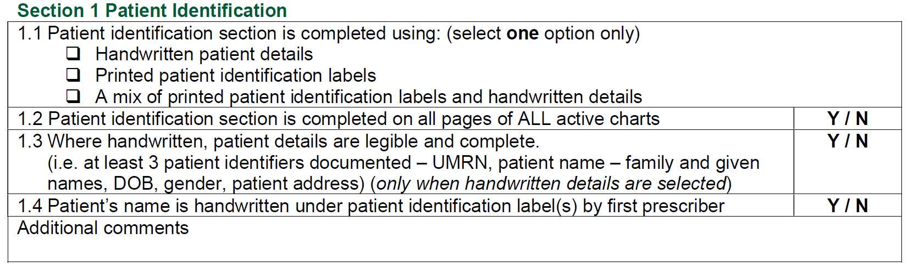
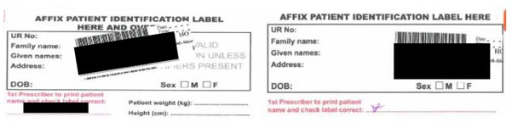
Patient Identification
1.1 Patient ID section is completed using:
Select ONE option.
1.2 Patient ID complete on all pages
Look at pages 3 and 4 of all current medication charts –
Select YES or NO accordingly.
Page 3 Page 4

Slide 14
Patient Identification
1.3 Handwritten patient details are legible
and complete
Only answer if "handwritten" or "a mix of printed and handwritten patient details" option was selected.
Select YES if at least three are present on WA HMC (visible and correct) :
Medical record number (UMRN)
Patient name (family and given names)
Date of birth
Gender
Patient address

Slide 15
Patient Identification
1.4 Patient’s name is handwritten under patient identification label(s) by first prescriber
Select YES if it is first prescriber
Select NO if it is another prescriber or pharmacist
If patient ID label is used, the first prescriber must print the patient’s name

Slide 16
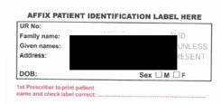
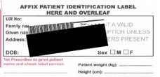
Patient ID - Example
1.1 Patient identification section is completed using: (select one option only) Handwritten patient details Printed patient identification labels A mix of printed patient identification labels and handwritten details
1.2 Patient identification section is completed on all pages of ALL active charts | Y / N
1.4 Patient’s name is handwritten under patient identification label(s) by first prescriber | Y / N
Additional comments
✓
NOTE: If you select the “Printed patient identification labels” option, you will automatically skip question 1.3

Slide 17
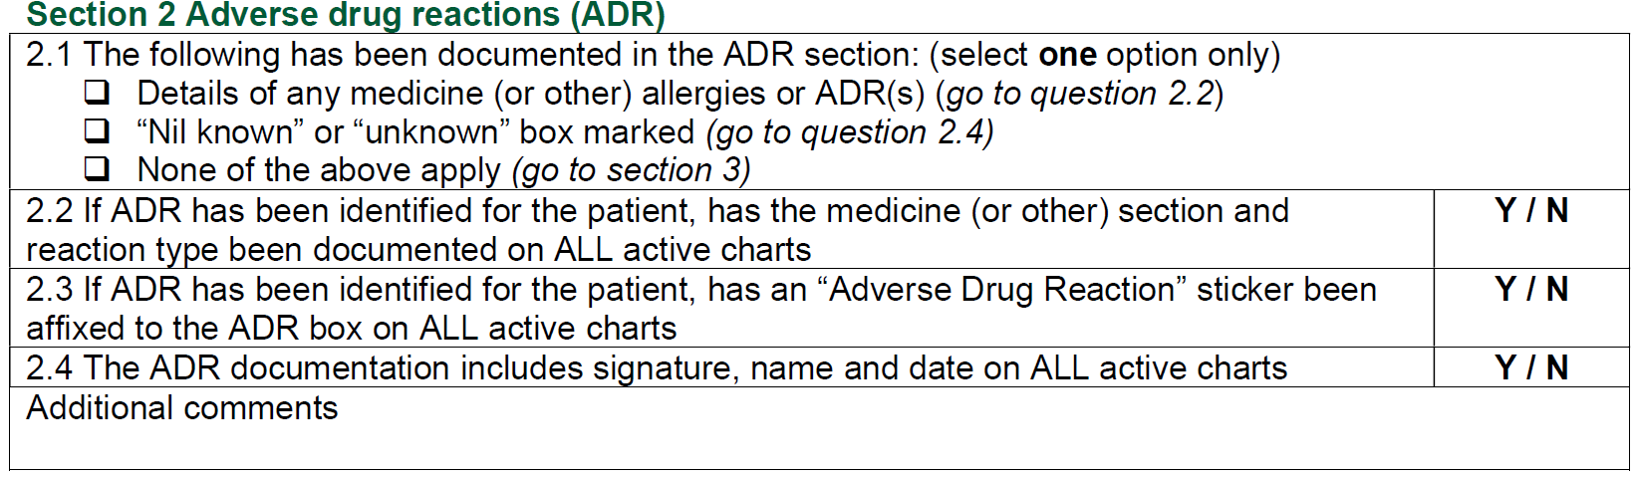
Adverse Drug Reaction (ADR) Details
2.1 The following has been documented in the ADR section
Select ONE option only.
Depending on your answer, you may be either be prompted within the REDCap program to answer all the questions in this section or move to section 3 of the audit.
2.2 If ADR has been identified for the patient, has the medicine (or other) section and reaction type has been documented on ALL active charts
Documentation needs to include medicine AND reaction type.
If reaction is documented as “patient unsure” or “patient can’t remember”, it is considered complete – select YES.

Slide 18
Adverse Drug Reaction (ADR) Details
2.3 If ADR has been identified for the patient, has an “Adverse Drug Reaction” sticker been affixed to the ADR box on ALL active charts
Select either YES or NO.
2.4 The ADR documentation includes signature, name and date on ALL active charts
Documentation needs to include name and signature of person documenting AND the date of documentation.

Slide 19
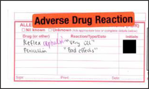
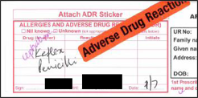
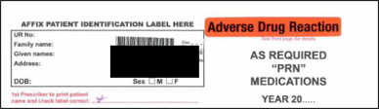
ADR - Example
2.1 The following has been documented in the ADR section: (select one option only) Details of any medicine (or other) allergies or ADR(s) (go to question 2.2) “Nil known” or “unknown” box marked (go to question 2.4) None of the above apply (go to section 3)
2.2 If ADR has been identified for the patient, has the medicine (or other) section and reaction type been documented on ALL active charts | Y / N
2.3 If ADR has been identified for the patient, has an “Adverse Drug Reaction” sticker been affixed to the ADR box on ALL active charts | Y / N
2.4 The ADR documentation includes signature, name and date on ALL active charts | Y / N
Additional comments
✓

Slide 20
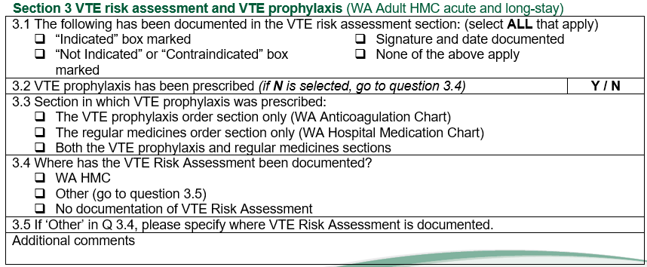
VTE Risk Assessment and
VTE Prophylaxis
Note: The following section has been adjusted accordingly to align with both WA HMC and WA Anticoagulation Medication Chart (WA AMC)

Slide 21

VTE risk assessment and prophylaxis
3.1 The following has been documented in the VTE risk assessment section: (select ALL that apply)
“Indicated” box marked “Not Indicated” or “Contraindicated” box marked | Signature and date documented None of the above apply
3.1 The following has been documented in the VTE risk assessment section (select ALL that apply)
Refer to Pharmacological Prophylaxis section:
  If “Indicated” box is marked select this option.
  If “Not indicated” or “Contraindicated” box is marked select this option.
If prescriber has signed and dated the VTE risk assessment box, select “signature and date documented”.
If VTE risk assessment box has not been completed on at least ONE of the active charts, select “none of the above apply”.

Slide 22
VTE Prophylaxis
3.2 VTE prophylaxis prescribed
Check whether the patient has been prescribed VTE prophylaxis
Select YES if pharmacological VTE prophylaxis has been prescribed
Select NO if no pharmacological VTE prophylaxis has been prescribed.
You will be directed to question 3.4
*WA public hospitals will only be considering pharmacological VTE prophylaxis (and not mechanical)

Slide 23
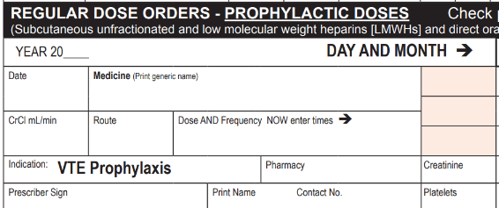
VTE Prophylaxis
3.3 Section in which VTE prophylaxis was prescribed: The VTE prophylaxis order section only (WA Anticoagulation Chart) The regular medicines order section only (WA Hospital Medication Chart) Both the VTE prophylaxis and regular medicines sections
3.3 Section in which VTE prophylaxis prescribed:
Select only ONE option as to where the VTE prophylaxis has been prescribed.
Refer to the “VTE prophylaxis order section” of the WA Anticoagulation Medication Chart. Select “VTE prophylaxis order section” if a pharmacological VTE agent has been prescribed here.
Refer to the “regular medicines order section” of the WA HMC. Select “regular medicines order section” if a pharmacological VTE agent has been prescribed here.

Slide 24
VTE Prophylaxis
3.4 Where has the VTE Risk Assessment been documented? WA HMC Other (go to question 3.5) No documentation of VTE Risk Assessment
3.5 If ‘Other’ in Q 3.4, please specify where VTE Risk Assessment is documented.
3.4 Where has the VTE Risk Assessment been documented?
Select only ONE option as to where the VTE Risk Assessment has been documented.
If this is documented elsewhere than the WA HMC, select ‘Other’ option and you will be prompted to specify where this is documented in Q3.5.
If there is no VTE Risk Assessment documented select ‘No documentation of VTE Risk Assessment.

Slide 25

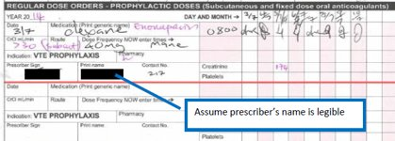
VTE risk assessment and
VTE prophylaxis
3.1 The following has been documented in the VTE risk assessment section: (select ALL that apply)
“Indicated” box marked “Not Indicated” or “Contraindicated” box marked | Signature and date documented None of the above apply
3.2 VTE prophylaxis has been prescribed (if N is selected, go to question 3.4) |  | Y / N
3.3 Section in which VTE prophylaxis was prescribed: The VTE prophylaxis order section only (WA Anticoagulation Chart) The regular medicines order section only (WA Hospital Medication Chart) Both the VTE prophylaxis and regular medicines sections
3.4 Where has the VTE Risk Assessment been documented? WA HMC Other (go to question 3.5) No documentation of VTE Risk Assessment
Additional comments
✓
✓
✓
✓

Slide 26
Acknowledgements
This local WA NSMC Audit 2024 has been adapted from the Australian Commission on Safety and Quality in Health Care NSMC Audit.
https://www.safetyandquality.gov.au/our-work/medication-safety/nsmc-audit
REDCap® Audit Link:
https://datalibrary-rc.health.wa.gov.au/surveys/?s=P83PEDAJW8DTDTDE
WA specific resources can be found here:
WA hospital medication chart (adult and paediatric) (health.wa.gov.au)
WA Medication Safety Intranet page

