Slide 1

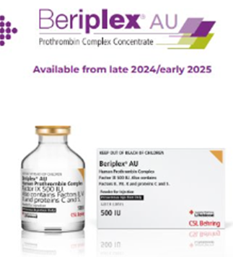
Warfarin over-treatment reversal updates on the WA Anticoagulation Medication Chart
BeriPLEX, a four-factor prothrombin complex concentrate (4FPCC) has replaced Prothrombinex-VF (Human Prothrombin Complex) in reversal of warfarin over-treatment. BeriPLEX is now available from the National Blood Authority (NBA).
The WA Anticoagulation Medication Chart (WA AMC) has been updated with recently published recommendations for warfarin
over-treatment reversal using BeriPLEX.
Robinson D et al. Updated recommendations for warfarin reversal in the setting of four-factor prothrombin complex concentrate. MJA 25 November 2024. https://onlinelibrary.wiley.com/doi/epdf/10.5694/mja2.52538
Note: BeriPLEX is displayed with mixed case lettering due to the availability of lookalike soundalike blood product BeriNERT.
Developed by: Medicines and Technology Unit, Patient Safety and Clinical Quality Division. Updated: January 2025

Slide 2

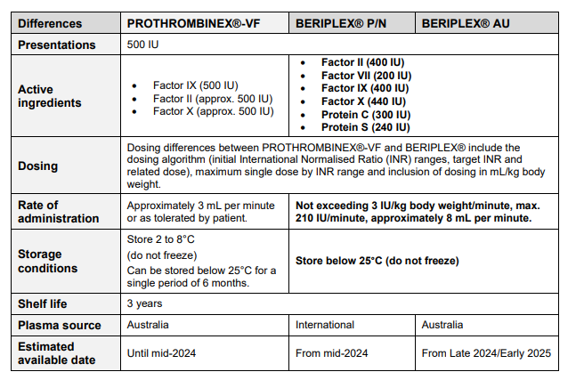
Differences between the products
*
*
Note:
BeriPLEX P/N is an imported product manufactured with plasma collected overseas.
BeriPLEX P/N is available until the Australian product BeriPLEX AU becomes available.
BeriPLEX P/N and BeriPLEX AU have identical compositions, and are interchangeable.
Prothrombinex-VF and BeriPLEX are both used in warfarin over-treatment but due to their composition, they are not bio-equivalent and cannot be used interchangeably.
*The active ingredients in BeriPLEX information relate to the 500 International Units vial. Please note that the factor activity is an approximate.

Slide 3

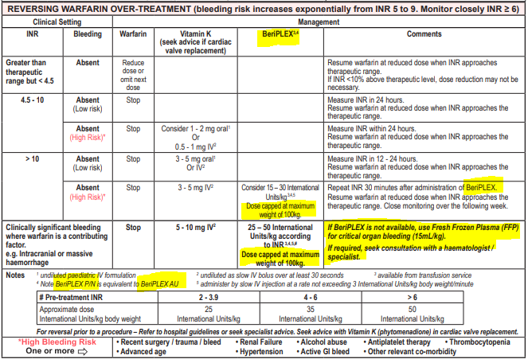
Updates to WA Anticoagulation Chart (change to BeriPLEX)
The WA Anticoagulation Medication Chart has been updated (v01/25) with dosing and indications for BeriPLEX.
The changes to the WA Anticoagulation Medication Chart are highlighted below:
Dose of BeriPLEX is capped at maximum patient weight of 100kg
Use of BeriPLEX as sole agent for reversing warfarin over treatment.
Pre-treatment INR range to guide dose of BeriPLEX
This table was developed with the expert advice from the WA Anticoagulation Steering Group

Slide 4
BeriPLEX dosing
BeriPLEX is indicated when:
there is clinically significant bleeding where warfarin is a contributing factor (e.g. intracranial or massive haemorrhage)
the patient’s INR is greater than 10 (INR > 10) and where there is a high risk of bleeding
Dose is based on body weight, up to but not exceeding patient weight of 100 kg.
Repeat INR 30 minutes after administration of BeriPLEX.
Dosing of BeriPLEX is shown below:
Pre-treatment INR | 2 - 3.9 | 4 – 6 | > 6
Approximate dose International Units/kg body weight | 25 International Units/kg | 35 International Units/kg | 50 International Units/kg

Slide 5
Administration of BeriPLEX
Reconstitute 500 International Units of BeriPLEX with
20 mL Water for Injection (WFI) using Mix2vial in box.
Administer by slow intravenous (IV) injection:
at a rate not exceeding 3 International Units/kg body weight/minute
up to a maximum of 210 International Units/minute (approximately 8 mL/minute)

